Slide 1
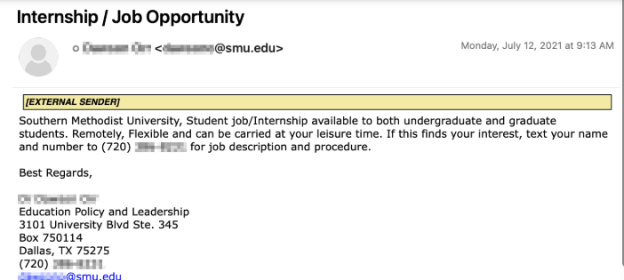
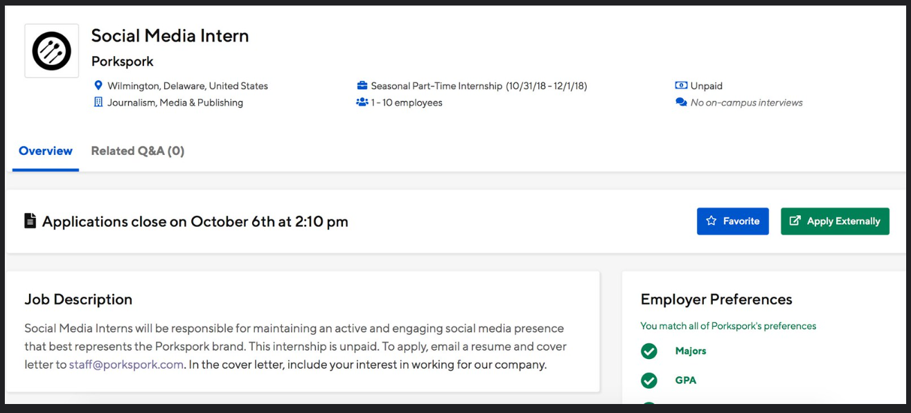
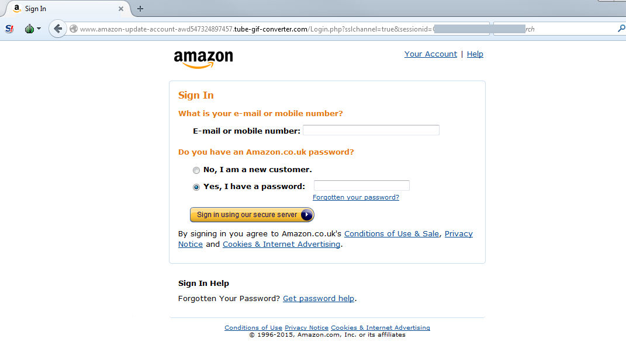
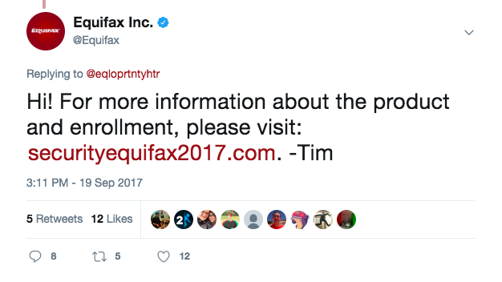

Slide 2
1. Check the URL
🛑 2. Look for Poor Design or Grammar
🔍 3. Check for a Padlock Icon
📞 4. Investigate Contact Information
🧾 5. Read Policies
🕵️‍♂️ 6. Look It Up
🧪 7. Check Domain Age

Slide 3

MASKTERS
Masters Of Unveiling The Mask Of Fraudsters

Slide 4




Team members
Akshara Gupta
Vaibhavi Srivastava
Ananya Tiwari
Snehal shukla

Slide 5
ABSTRACT
Maskters is a user-friendly web-based tool developed to help users identify potentially fraudulent websites using core web technologies like HTML, CSS, and Python. The system evaluates critical indicators of website authenticity, such as domain information, HTTPS presence, and key content like privacy and return policies. By utilizing WHOIS lookup libraries in Python, it extracts valuable domain registration data—including creation and expiry dates—to detect suspicious or newly registered websites. Maskters also assesses design consistency, grammar, and trust signals like padlock icons to determine credibility. What sets Maskters apart is its unique, streamlined approach: unlike conventional tools, it delivers meaningful results without relying on heavy machine learning models or third-party APIs. This makes Maskters one of a kind—offering an accessible, efficient, and informative solution for safer browsing. With its intuitive interface and insightful safety scoring, Maskters empowers users to make smarter online decisions and avoid scams in the ever-evolving digital landscape.

Slide 6
TECHNOLOGIES USED
🧠 PROGRAMMING
PYTHON :Primary language for backend logic and data processing
🌐 WEB FRAMEWORK
FLASK :Lightweight python web framework to build the maskters web interface (maskters.Com)
🔍 WEBSITE ANALYSIS TOOLS & TECHNIQUES
WHOIS LOOKUP LIBRARY: Used to check domain registration date and domain age
SSL VERIFICATION LIBRARIES: Ssl, socket, or custom https checker
: detects if the site uses a valid ssl certificate
💻WEBSITE DEVELOPMENT
HTML: It provides structure of the website
CSS: It is used for styling.

Slide 7
KEY NOVEL ASPECTS
USP OF PROJECT
🧠 Multi-Factor Trust Scoring System
📋 Human-Like Judgment Emulation
🔒 Real-Time Analysis
🛠 Modular and Extensible Framework
🌐 Aims for Full Web Deployment (maskters.com).
Feature | 🟣 Maskters | 🔴 Others
✅ Trust Score with Explanation | ✔️ Available | ❌ Not Available
✅ Grammar & Design Quality Check | ✔️ Available | ❌ Not Available
✅ Modular for Future Integrations | ✔️ Available | ⚠️ Limited
✅ Real-time Domain Checks (WHOIS, SSL) | ✔️ Available | ✔️ Available
✅ Educates Users While Scanning | ✔️ Available | ❌ Not Available
✅ Plans for Public Site (maskters.com) | ✔️ Available | ❌ Not Available
.

Slide 8
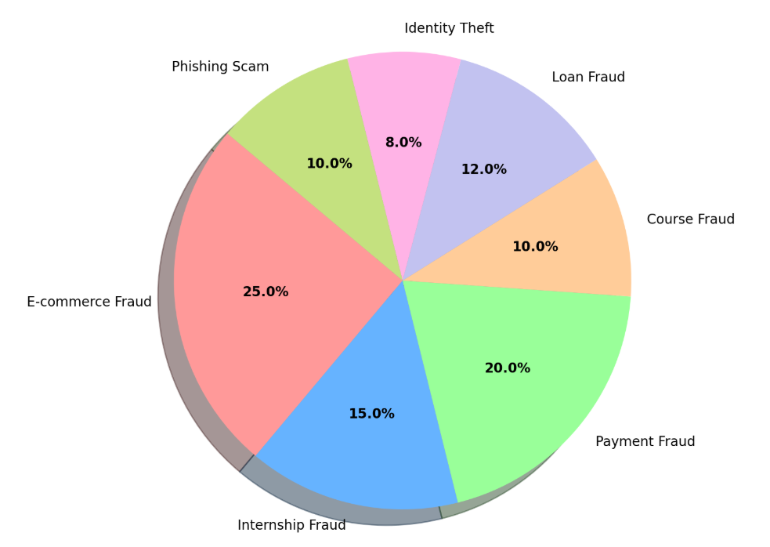
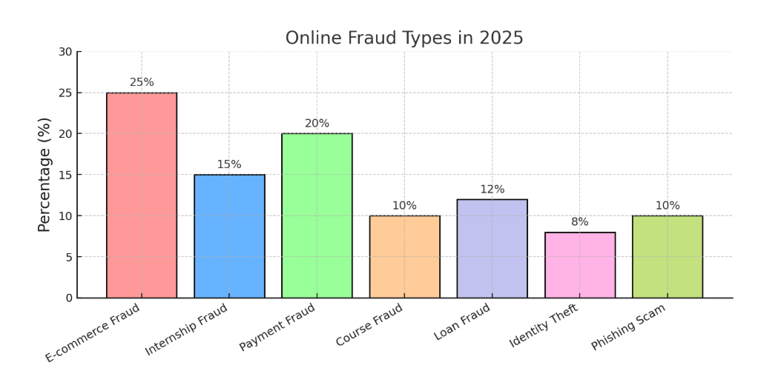
STATISTICS OF ONLINE FRAUD IN 2025

Slide 9
🕵️‍♂️ Fraud Type | 👥 Number of People (out of 1,00,000) | 📝 Description
🔴 E-commerce Fraud | 25,000 | Fake online stores trick users into paying.
🔵 Internship Fraud | 15,000 | Scammers offer fake internships for money.
🟢 Payment Fraud | 20,000 | Unauthorized or deceptive transactions occur.
🟠 Course Fraud | 10,000 | Fake courses charge fees without delivering value.
🟣 Loan Fraud | 12,000 | False loan offers used to steal personal info.
🌸 Identity Theft | 8,000 | Personal data is stolen and misused.
🟡 Phishing Scam | 10,000 | Fake messages trick users into sharing details.

Slide 10
WHY MASKTERS ??
All-in-one scam detection tool
Easy-to-use interface
Real-time website analysis
Clear safety score (percentage-based)
No personal data required
Phone number and email validation
Checks for HTTPS, padlock, grammar, and design
Detects missing or fake policies
Continuously improving with new features
Free and accessible to everyone

Slide 11
Feature / Tool | Maskters | Google Safe Browsing | Norton Safe Web | ScamAdviser
🧠 AI-style trust scoring | ✅ Custom safety % score | ❌ No | ❌ No | ✅ Basic trust score
🔍 Checks for SSL (https) | ✅ Yes | ✅ Yes | ✅ Yes | ✅ Yes
🕵️ Domain age & WHOIS check | ✅ Yes | ❌ No | ❌ No | ✅ Yes
✍️ Grammar/design analysis | ✅ Yes | ❌ No | ❌ No | ❌ No
📋 Checks for return/privacy policy | 🔜 Coming Soon (planned) | ❌ No | ❌ No | ✅ Sometimes
📞 Phone/email verification | 🔜 Planned (e.g., Truecaller, SMTP) | ❌ No | ❌ No | ❌ No
⚡ Speed & user-friendliness | ✅ Very lightweight & fast | ✅ Fast | ⚠️ Can be slow sometimes | ⚠️ Moderate
🧩 Easy to integrate into websites | ✅ Built with Flask (customizable) | ❌ Closed system | ❌ Closed system | ❌ Closed system
🌐 Works offline / local use | ✅ Yes (can run on local PC) | ❌ Needs internet | ❌ Needs internet | ❌ Needs internet
💰 Cost | 🆓 100% Free & Open | 🆓 Free | 🆓 Free | 🆓 Free

Slide 12
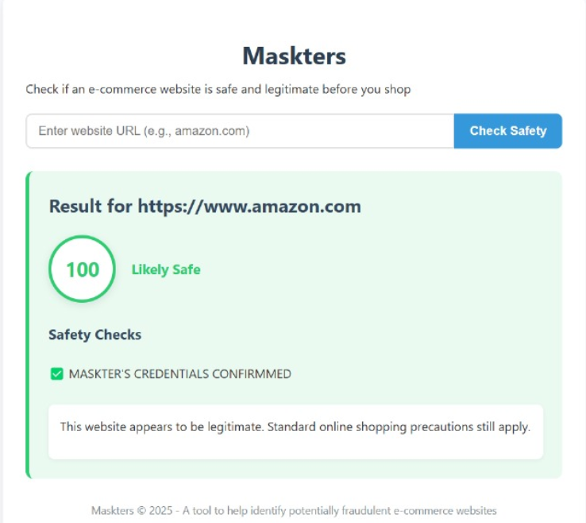
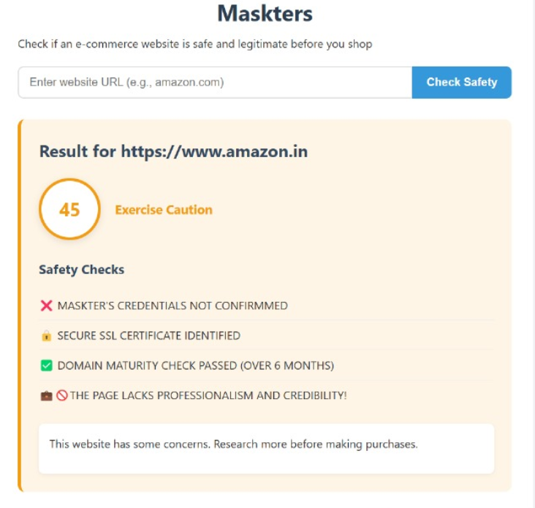
FEATURES OVERVIEW

Slide 13
CONCLUSION
1. Maskters is a platform built to promote safer web experiences by detecting fraudulent websites using simple, effective methods.
2. Future plans include:
Adding payment fraud /course fraud checker to protect users.
Improving the user interface for a smoother, more intuitive experience
3. Maskters also presents opportunities for monetization:
Hosting ads on the website to generate revenue.
Introducing a “Maskter Verified” badge for trustworthy websites,
4. Overall, Maskters is evolving into a multi-functional platform for online safety, trust-building, and awareness.

Slide 14
ACKNOWLEDGEMENT
We would like to express our sincere gratitude to our mentors, peers, and everyone who supported us throughout the development of Maskters. Their guidance, feedback, and encouragement played a vital role in shaping this project. We also appreciate the open-source community and the creators of the libraries we used, whose contributions made this work possible

